Slide 1
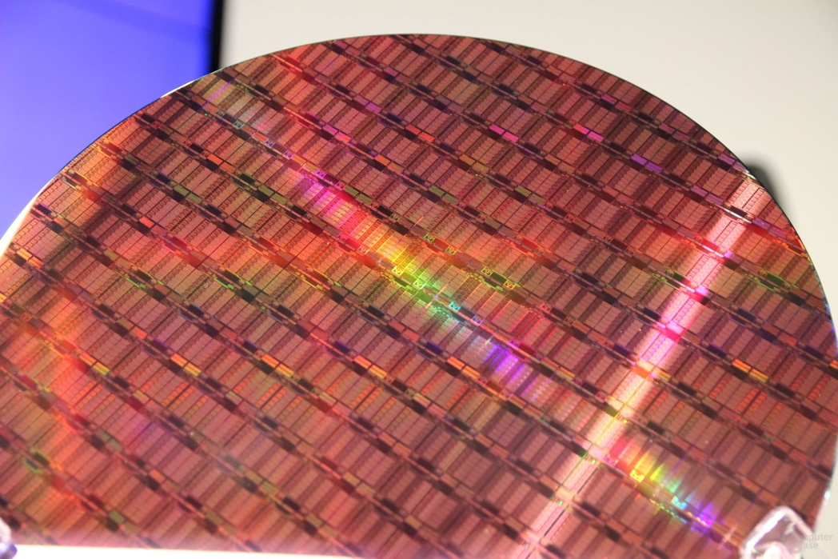
Revolution III: Explicit Parallelism
Modern Multicore Processor
Intel Xeon E5-2699 V4 (2016)
Application: server
Technology: 14nm (16% of P4)
7.2B transistors (130x)
456 mm² (4.5x)
2.4 to 3.6 Ghz (~1x)
1.8 Volts (~1x)
256-bit data (2x)
14-stage pipelined datapath (0.5x)
4 instructions per cycle (1x)
Three levels of on-chip cache
data-parallel vector (SIMD) instructions, hyperthreading
22-core multicore (22x)
Notes:
Then to support explicit data & thread level parallelism
Hardware provides parallel resources, software specifies usage
Why? diminishing returns on instruction-level-parallelism
First using (subword) vector instructions…, Intel’s SSE
One instruction does four parallel multiplies
… and general support for multi-threaded programs
Coherent caches, hardware synchronization primitives
Then using support for multiple concurrent threads on chip
First with single-core multi-threading, now with multi-core
Graphics processing units (GPUs) are highly parallel
Converging with general-purpose processors (CPUs)?

Slide 2
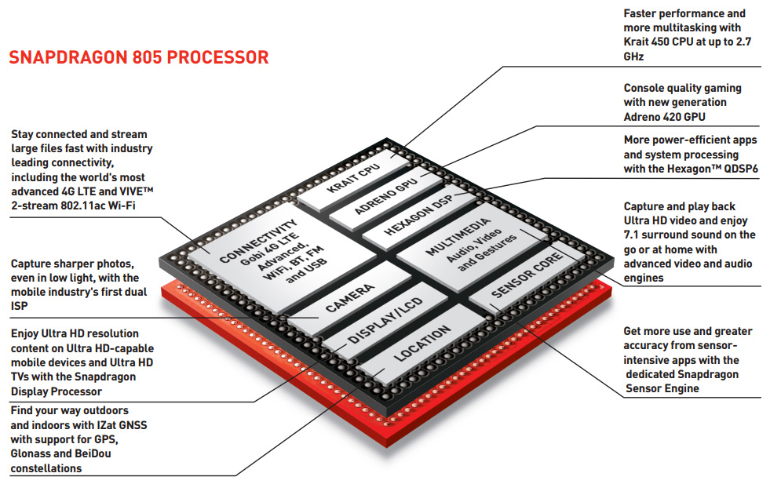
Revolution IV: Heterogeneous Processing
c/o Qualcomm
Notes:
Combining multiple kinds of compute engines in one die
not just homogenous collection of cores
System-on-Chip (SoC) is one common example in mobile space
Lots of stuff on the chip beyond just CPUs
Graphics Processing Units (GPUs)
throughput-oriented specialized multicore processors
good for gaming, machine learning, computer vision, …
Special-purpose logic
media codecs, radios, encryption, compression, machine learning
Excellent energy efficiency and performance
extremely complicated to program!

Slide 3
Cerebras: Wafer-Scale Engine 2
Apple M2 ➔ 5 nm
ASML ➔ 2 nm

Slide 4
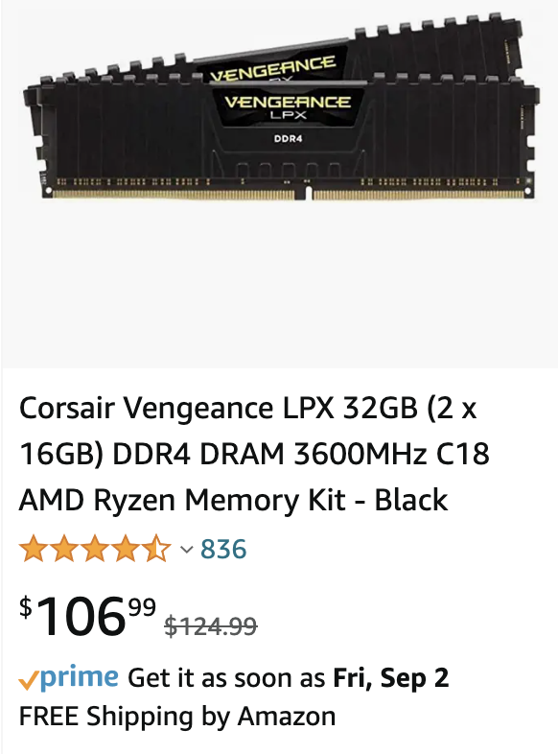
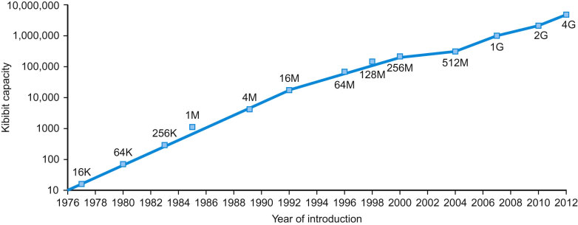
Technology Trends: Memory Capacity
2022
FIGURE 1.11 Growth of capacity per DRAM chip over time. The y-axis is measured in kibibits (2¹⁰ bits).
The DRAM industry quadrupled capacity almost every three years, a 60% increase per year, for 20 years.
In recent years, the rate has slowed down and is somewhat closer to doubling every two years to three years.

Slide 5
Technology Trends: Memory Capacity (Future)
Is hardware research dead?

Slide 6
Spintronics
2D Materials
Ferroelectric
RAM
IEEE International Electron Devices Meeting (IEDM) December 2021
Notes:
Photonics + Quantum + Material Science has a lot to do in future computing technologies

Slide 7
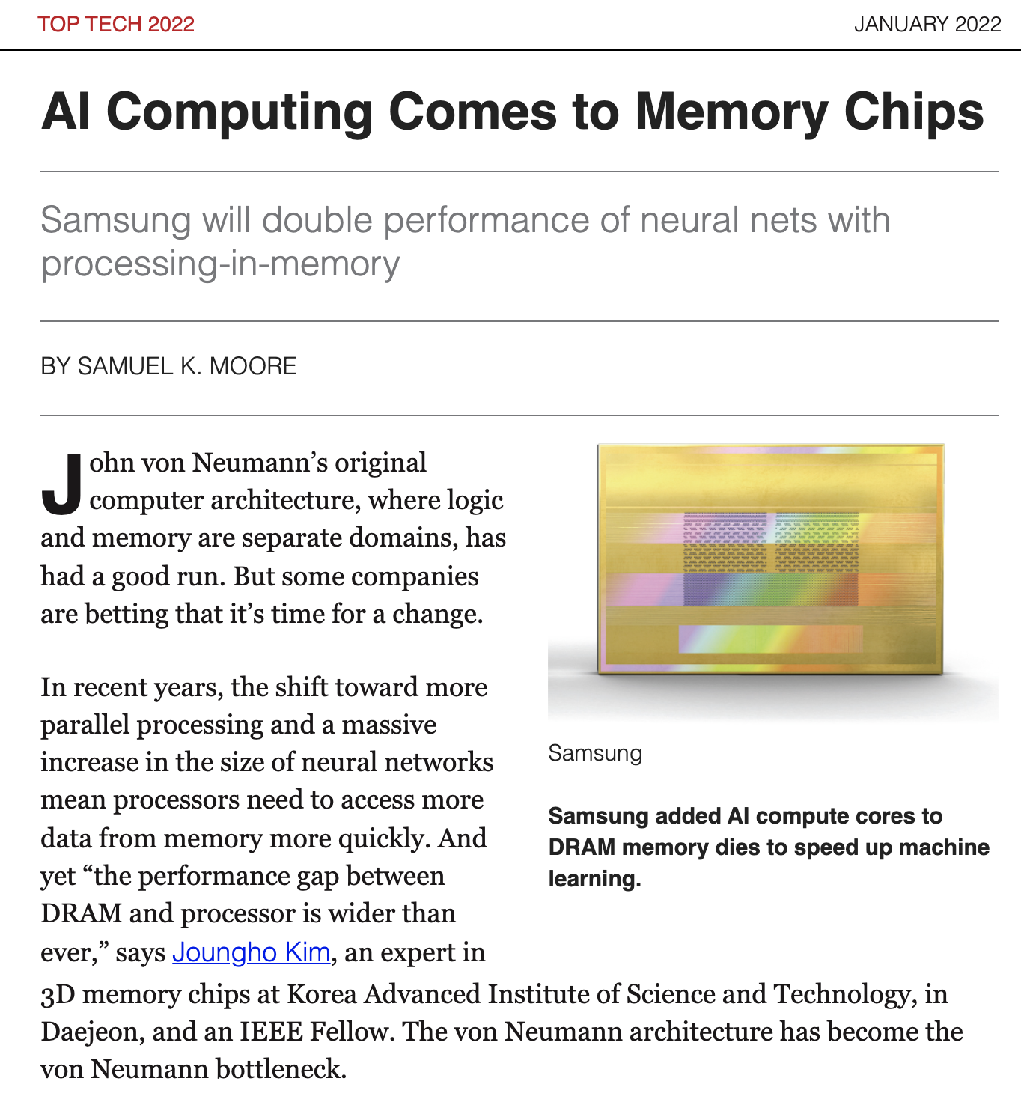
IEEE
Spectrum
Notes:
Even though we will talk about a technology developed decades ago, it will give you understanding of today’s research topics!

Slide 8
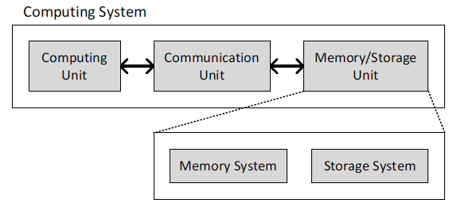
Don’t Panic
In this course, we will only cover the basics
So, when we say a computer, we mean a device that can compute, communicate, and store some information
The things we will learn in this course can be used almost in device with a processor and a memory!

Slide 9
Course Objectives
To learn the organizational paradigms that determine the capabilities and performance of computer systems
To understand the interactions between the computer’s architecture and its software so that
future software designers (compiler writers, operating system designers, database programmers, …) can achieve the best cost-performance trade-offs
future architects understand the effects of their design choices on software applications
Read Chapter 1, Sections 1-12, before our next class (9/7)

